Slide 1

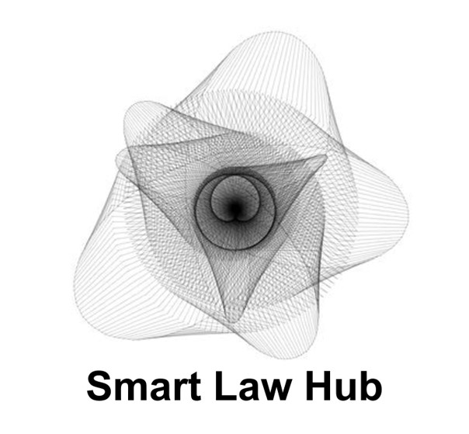

How to Build a Belgian Brain Data Hub ?
A Proof of Concept for an altruistic Data Platform
Prof. Gregory Lewkowicz
Director of the Smart Law Hub, ULB
Principal investigator at FARI (AI for the Common Good Institute)

Slide 2

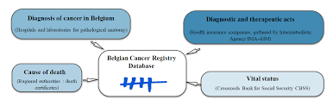
Cancer Registry

Slide 3
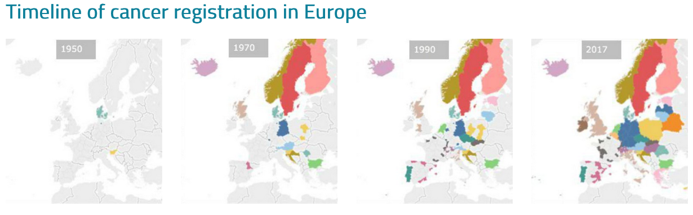

67 years of cancer registration in Europe

Slide 4
Road to the Cancer Registry
1983
National Cancer Registry
1994 – 2005
Cancer registration network in Flanders
2003
Compulsory participation in the cancer registry
2005
Foundation of the Belgian Cancer Registry
2006
Legal recognition of the Belgian Cancer Registry

Slide 5

Brain Health Registry ?
How to contribute ?
What can be done now in a bottom-up perspective ?

Slide 6
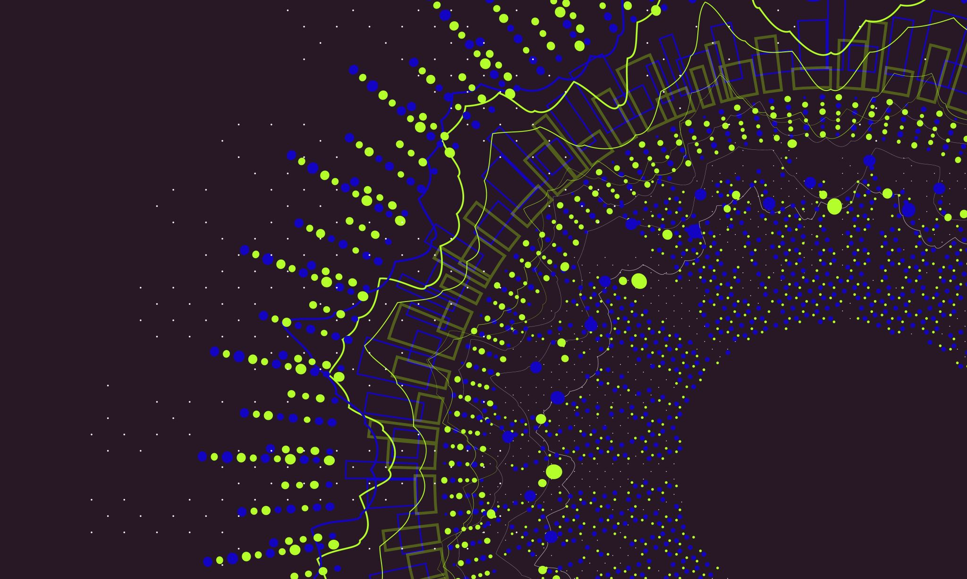
How to harness European data regulations ?

Slide 7
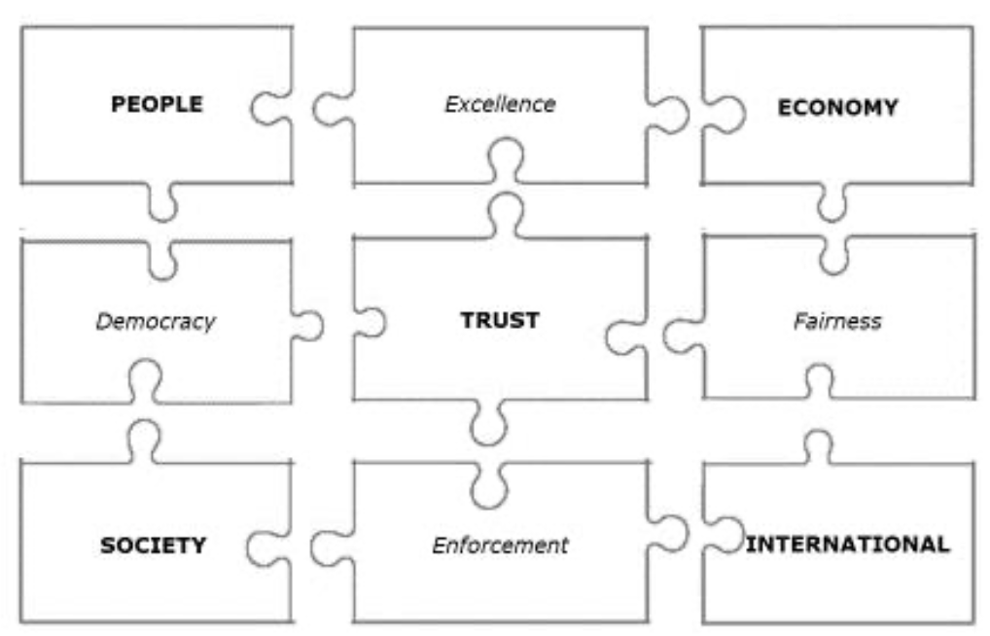
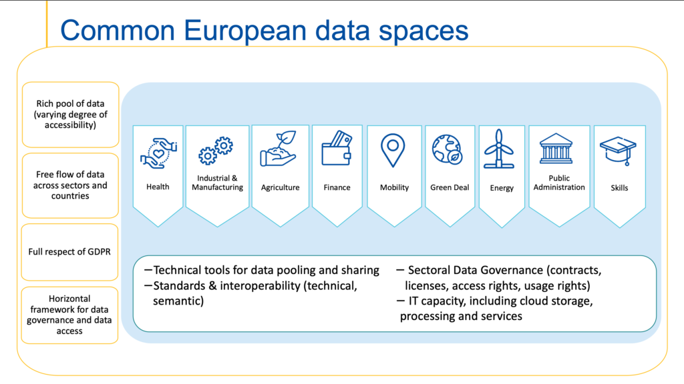
European Data Spaces

Slide 8
General Data Protection Regulation
Regulation (EU) 2016/679 of the European Parliament and of the Council of 27 April 2016 on the protection of natural persons with regard to the processing of personal data and on the free movement of such data, and repealing Directive 95/46/EC (General Data Protection Regulation) (Text with EEA relevance)

Slide 9
General Data Protection Regulation
Article 15 - Right of access by the data subject
3. The controller shall provide a copy of the personal data undergoing processing. Where the data subject makes the request by electronic means, and unless otherwise requested by the data subject, the information shall be provided in a commonly used electronic form.
Article 20 - Right to data portability
1. The data subject shall have the right to receive the personal data concerning him or her, which he or she has provided to a controller, in a structured, commonly used and machine-readable format and have the right to transmit those data to another controller without hindrance from the controller to which the personal data have been provided

Slide 10
Health Data
Article 9 - Processing of special categories of personal data
1. Processing of (…) data concerning health (…) shall be prohibited.
2. Paragraph 1 shall not apply if one of the following applies:
(a) the data subject has given explicit consent to the processing of those personal data for one or more specified purposes, except where Union or Member State law provide that the prohibition referred to in paragraph 1 may not be lifted by the data subject;

Slide 11
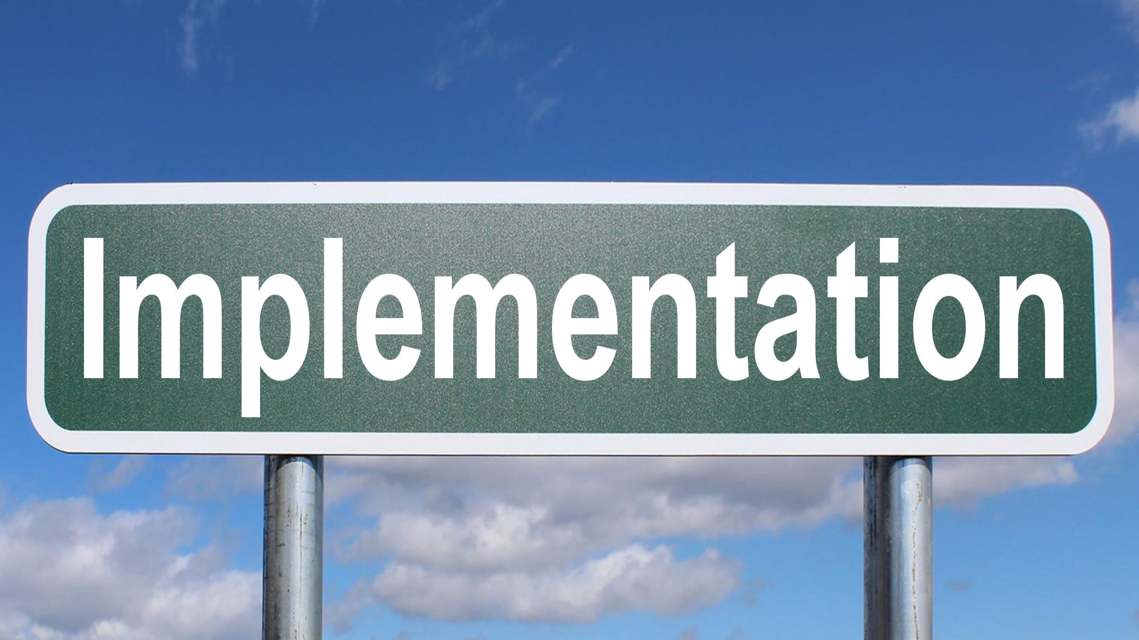
Right of access and right to data portability are difficult to implement by individual people

Slide 12
Data Governance Act
Regulation (EU) 2022/868
(applicable from September 24, 2023)
Article 10 – Data Intermediation Services
(b) intermediation services between data subjects that seek to make their personal data available or natural persons that seek to make non-personal data available, and potential data users, including making available the technical or other means to enable such services, and in particular enabling the exercise of the data subjects’ rights provided in Regulation (EU) 2016/679;

Slide 13
Data Governance Act – Data Altruism
Article 2 – Definitions
(16) ‘data altruism’ means the voluntary sharing of data on the basis of the consent of data subjects to process personal data pertaining to them, or permissions of data holders to allow the use of their non-personal data without seeking or receiving a reward that goes beyond compensation related to the costs that they incur where they make their data available for objectives of general interest as provided for in national law, where applicable, such as healthcare, combating climate change, improving mobility, facilitating the development, production and dissemination of official statistics, improving the provision of public services, public policy making or scientific research purposes in the general interest;

Slide 14
Data Governance Act
Data Altruism organizations have less compliance obligations than other intermediation services
Article 15 - Exceptions
This Chapter shall not apply to recognised data altruism organisations or other not-for-profit entities insofar as their activities consist of seeking to collect data for objectives of general interest, made available by natural or legal persons on the basis of data altruism, unless those organisations and entities aim to establish commercial relationships between an undetermined number of data subjects and data holders on the one hand and data users on the other.

Slide 15
Data Governance Act
Article 25 - European data altruism consent form
1. In order to facilitate the collection of data based on data altruism, the Commission shall adopt implementing acts establishing and developing a European data altruism consent form, after consulting the European Data Protection Board, taking into account the advice of the European Data Innovation Board and duly involving relevant stakeholders. The form shall allow the collection of consent or permission across Member States in a uniform format. Those implementing acts shall be adopted in accordance with the advisory procedure referred to in Article 33(2).
(…)
4. The form shall be available in a manner that can be printed on paper and is easily understandable as well as in an electronic, machine-readable form.

Slide 16
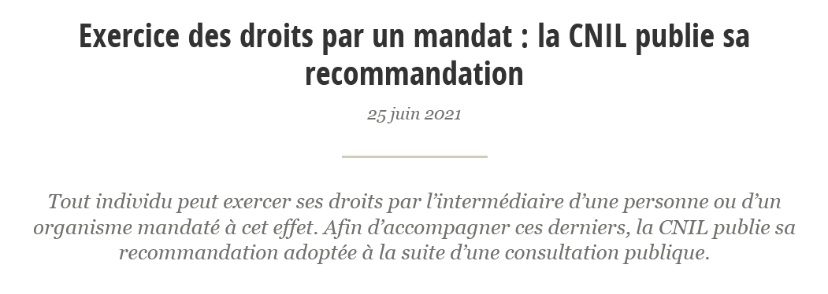
Exercising rights through a written mandate
Article 1984 of the Belgian Civil Code
« Le mandat ou la procuration est un acte par lequel une personne donne à une autre le pouvoir de faire quelque chose pour le mandant et en son nom. Le contrat ne se forme que par l'acceptation du mandataire »
« Lastgeving of volmacht is een handeling, waarbij een persoon aan een ander de macht geeft om iets voor de lastgever en in zijn naam te doen. Het contract komt slechts tot stand door de aanneming van de lasthebber.”

Slide 17
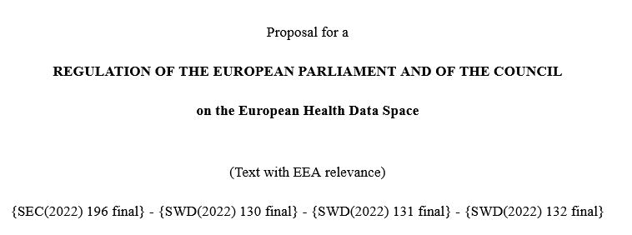
European Health Data Space (Regulation)
Article 40 - Data altruism in health
1.When processing personal electronic health data, data altruism organisations shall comply with the rules set out in Chapter IV of Regulation […] [Data Governance Act COM/2020/767 final]. Where data altruism organisations process personal electronic health data using a secure processing environment, such environments shall also comply with the requirements set out in Article 50 of this Regulation.

Slide 18
Introducing the Belgian Brain Data Hub
A Proof of Concept for an altruistic Data Platform

Slide 19


Belgian Brain Data Hub
A Secured Data Platform to Share your Data for Research and Policy in accordance with European Law
Proof of concept

Slide 20
Processes
Secured registration
Input own data
Secured signature of a mandate to allow the association to acquire health data
Secured signature of an explicit consent for the processing of health data for specified purposes
Setting up of the Patient Account and View
Multilingual explanation of the platform policies
Patient – Data Subject
Data Provider
Reception of formal data request
Secured Login
Multilingual explanation of the platform policies and code of ethics
Secured data provisioning environment: upload document or fill out a form
Aknowledgment and legal documentation
Contractual agreements
Secured registration
Description of data request (kind of data, purpose, period of time)
Secured signature of a data use licence
Secured signature of the association code of ethics
Secured access to data
Eligibility checks : purpose, data infrastructure, security measures
Data User

Slide 21
General Overview
Monitoring and control by patient
Patient Process
DB 1 – Personal Data
Patient own data input
Quality control
Data User Process
JOBS
Data Provider Process 1
Data Provider Process 2
Data Provider Process 3
Anonymization Engine
DB 2 – Anonymized Data
Statistical Information
Statistical information sources

Slide 22
General Overview
Belgian Brain Data Hub
Explicit consent
art. 9.1 GDPR
Patient
Mandate
art. 15 & 20 GDPR
Contractual agreements
Code of Ethics
Data Use Licences
Data Provider
Data User

Slide 23
Demo

Slide 24
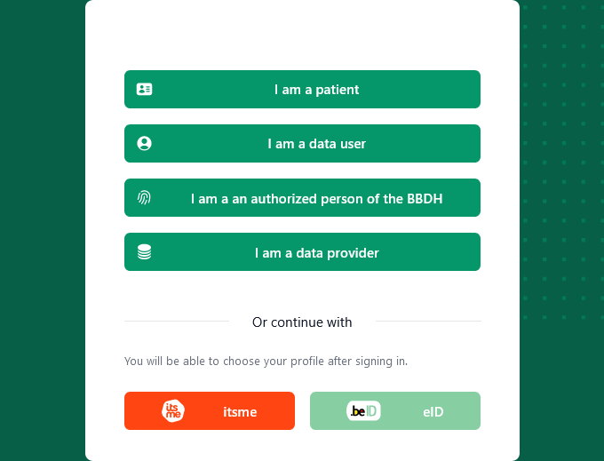
Belgian Brain Data Hub
A Secured Data Platform to Share your Data for Research and Policy in accordance with European Law
Notes:
https://brainhub.dev.hayolabs.com/

Slide 25
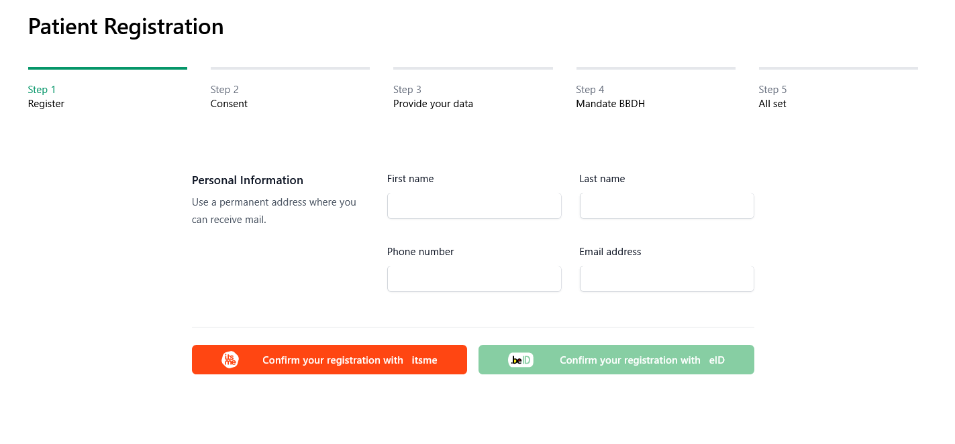

Slide 26
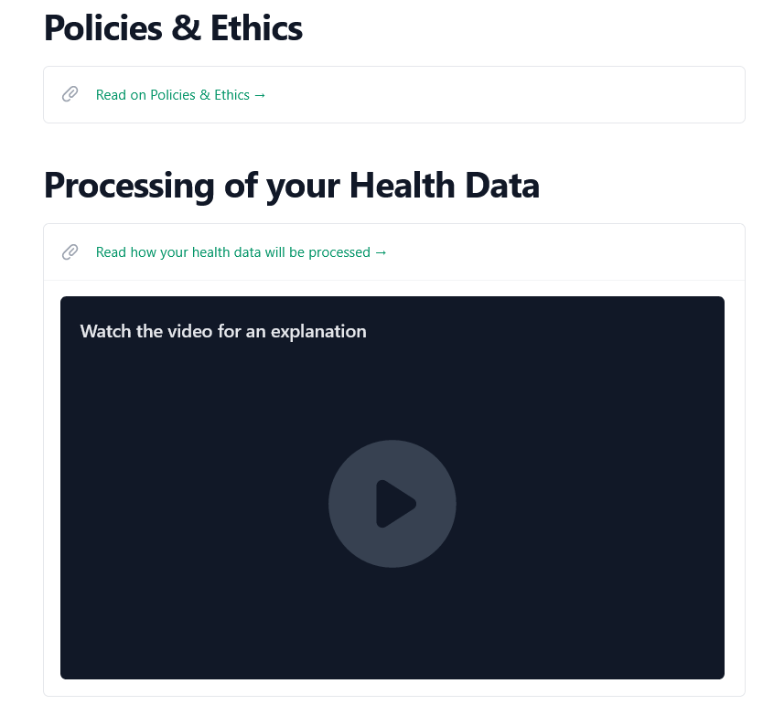
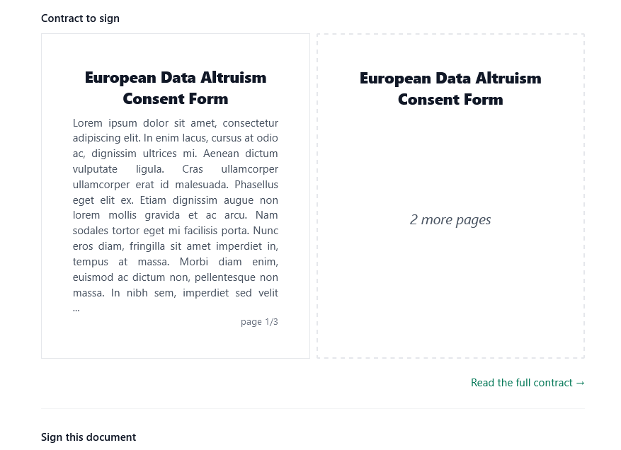

Slide 27
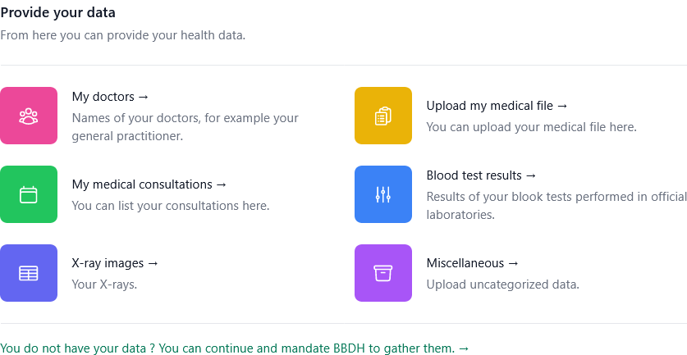

Slide 28
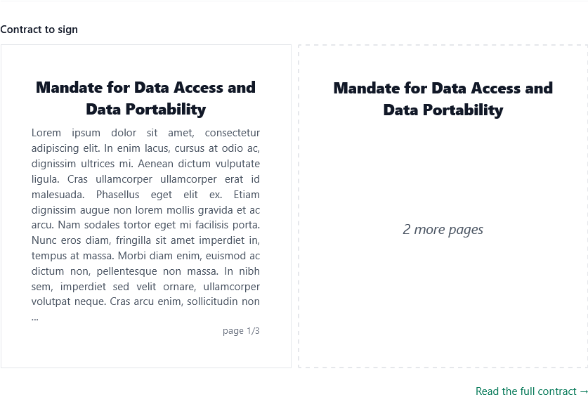
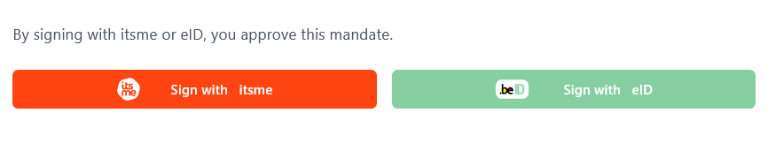

Slide 29
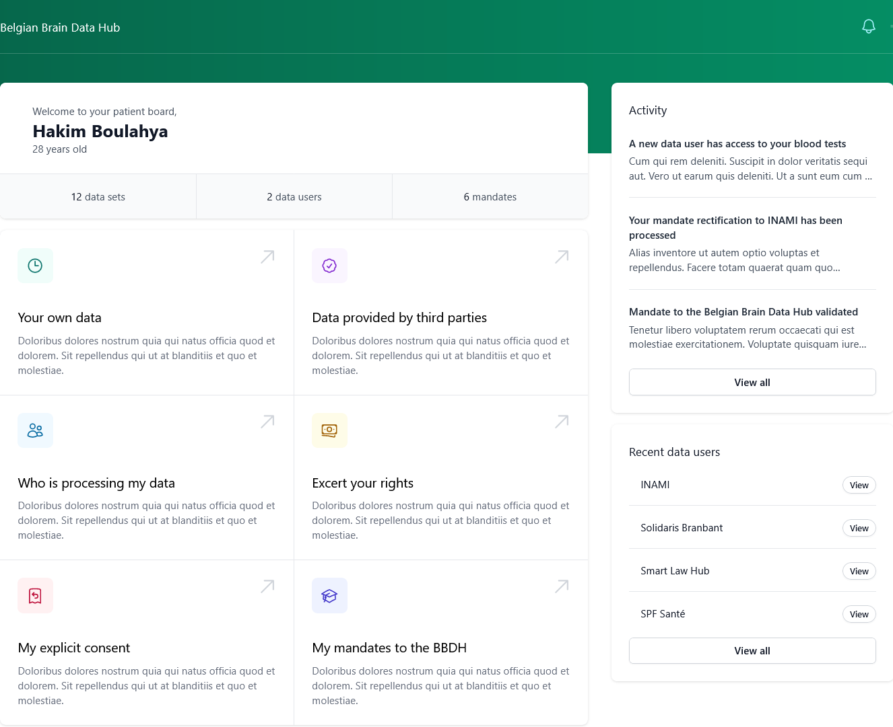

Slide 30
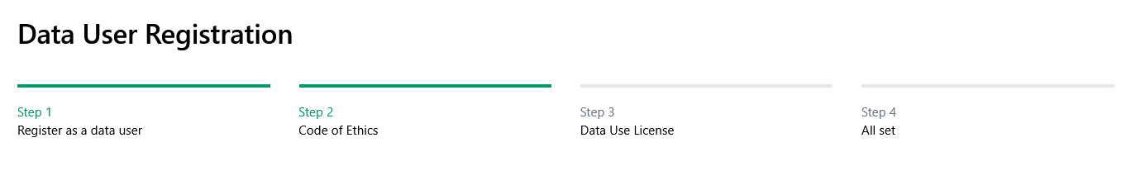
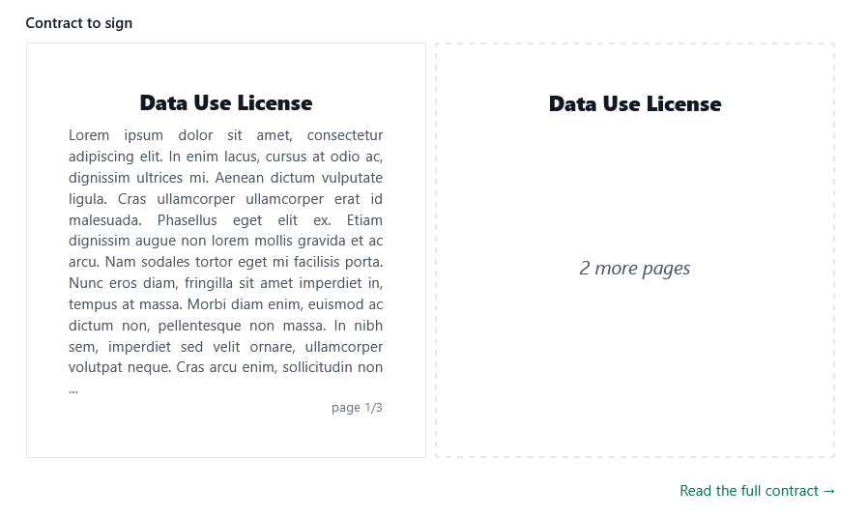


Slide 31
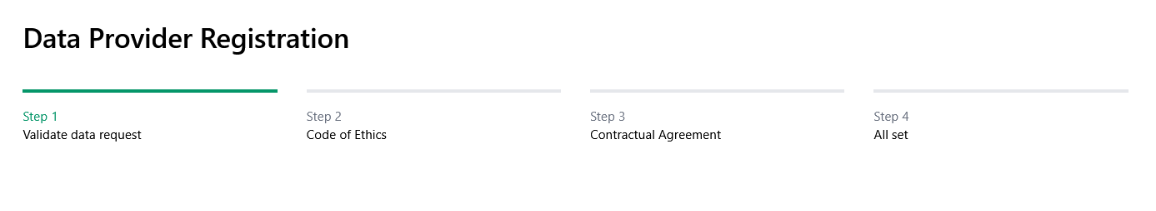
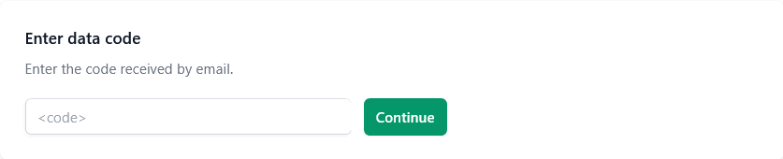
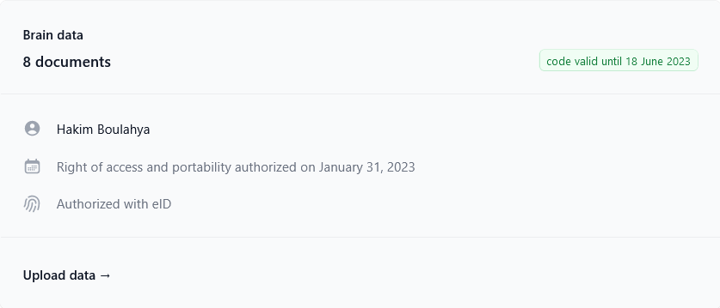

Slide 32
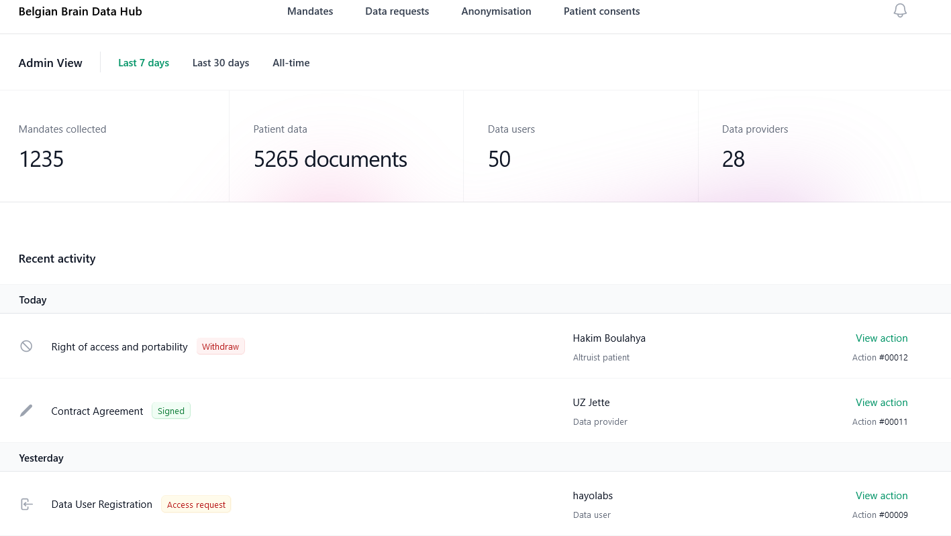
BBDH – View

Slide 33
Belgian Brain Data Hub
Thank you
A Secured Data Platform to Share your Data for Research and Policy in accordance with European Law
Proof of concept

